Slide 1

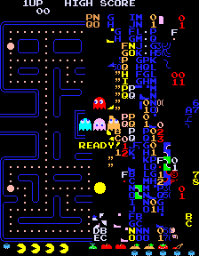
Pac-man
Aaron Kirtland & Caleb Stickney

Slide 2
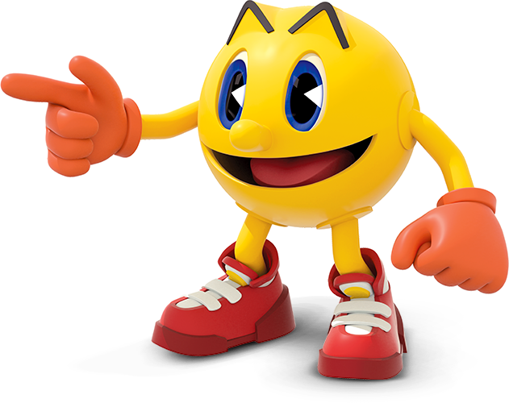
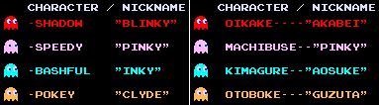
Topic
We are making Mathematica version of Pac-man!

Slide 3
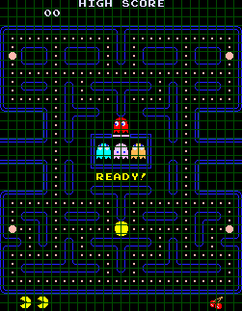
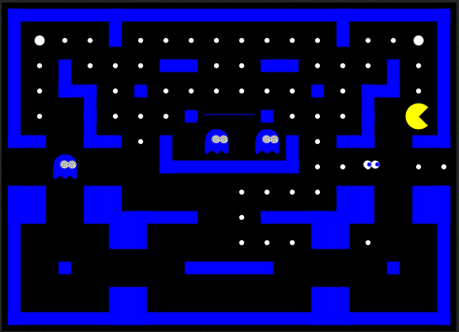
Ideal
We hope for the game to appear, and function, just as it actually does in arcades.

Slide 4
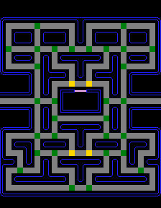
Ghost Movement
 | PAC-MAN SPEED |  |  |  | GHOST SPEED
LEVEL | NORM | NORM DOTS | FRIGHT | FRIGHT DOTS | NORM | FRIGHT | TUNNEL
1 | 80% | 71% | 90% | 79% | 75% | 50% | 40%
2 - 4 | 90% | 79% | 95% | 83% | 85% | 55% | 45%
5 - 20 | 100% | 87% | 100% | 87% | 95% | 60% | 50%
21+ | 90% | 79% | - | - | 95% | - | 50%

Slide 5
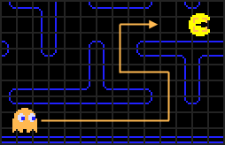
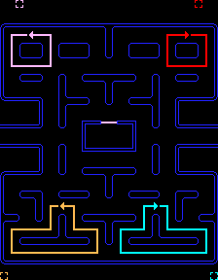
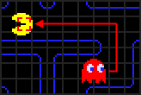
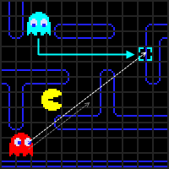
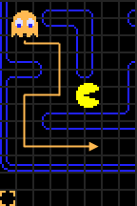
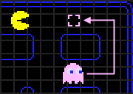
Ghost Targeting
Scatter Chase

Slide 6
Idealizations
While the actual game involves a set of 8x8 pixel tiles, our game only includes these tiles.
This means that we cannot change the speed of Pac-man and the ghosts as the levels progress, or due to mode changes.
In the actual game the walls occupy less space than one tile each, and Pac-man and ghost sprites occupy more than one tile. In our game, all entities and walls occupy 1 tile.

Slide 7
Accomplishments
Thus far the following features have been implemented:
A map.
Pac-man’s movement is player controlled.
Ghosts follow an AI pattern similar to in the actual game.
Score dots are eaten by Pac-man.
Power dots transform ghosts to frightened mode.
Partially implemented collisions.

Slide 8
Future
Complete collisions
Multiple levels
Multiple maps
Score
Lives
Minor graphic improvements: Pac-man changing direction, etc.
Pac-Man AI using

Slide 9
References
http://gameinternals.com/post/2072558330/understanding-pac-man-ghost-behavior
http://www.gamasutra.com/view/feature/3938/the_pacman_dossier.php?print=1

